Slide 1

Genome-Phenome analysis of neoplasm-related traits across the primate phylogeny
07-12-20
Alejandro Valenzuela, Gerard Muntané and Arcadi Navarro

Slide 2
Genome-Phenome analysis of neoplasm-related traits across the primate phylogeny
We set out to do a quick-and-dirty genome-phenome analysis for neoplasm-related traits provided by Amy using publicly available primate genomes.
We take a quick peek at what can be obtained from the whole set of primate data.
We focus on protein-coding regions, and we report the preliminary results of two different approaches:
The search for Convergent Amino Acid Substitutions linked to changes in the traits under study.
The search for correlations between rates of protein evolution and the same traits, using Phylogenetic-Generalized Least Squares

Slide 3
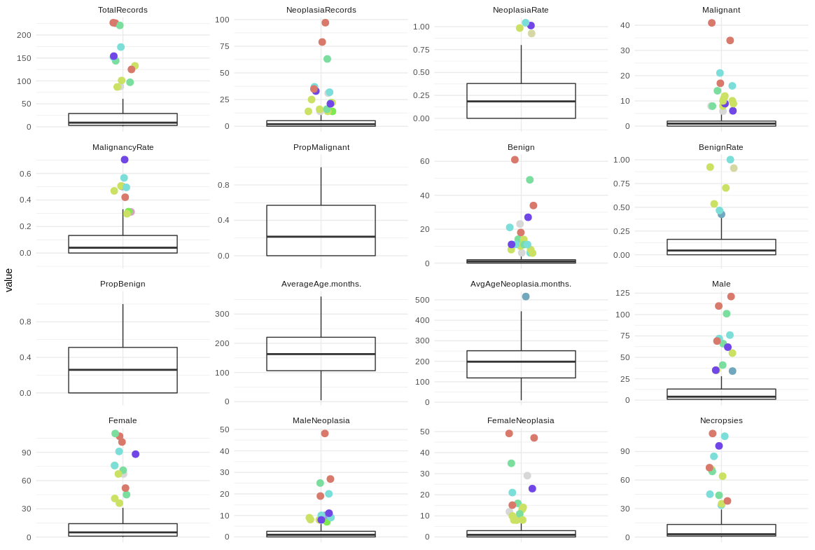
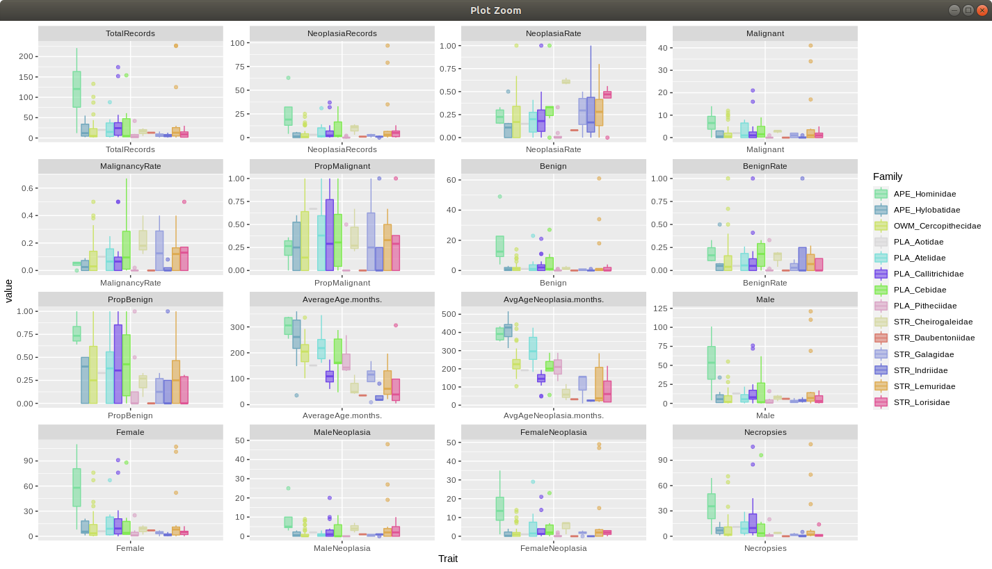
A quick look at the traits

Slide 4
A quick look at the traits

Slide 5
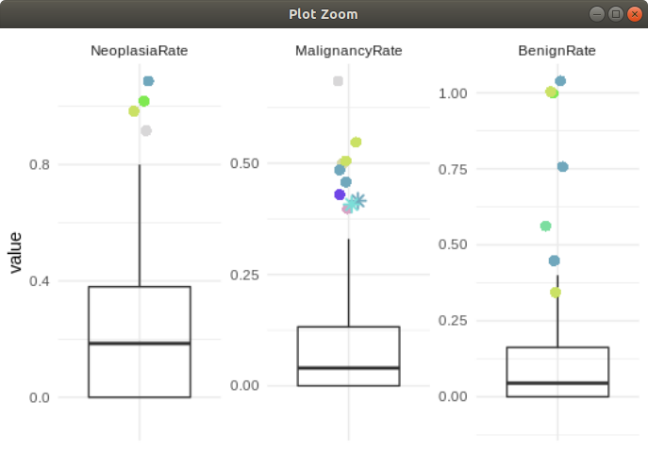
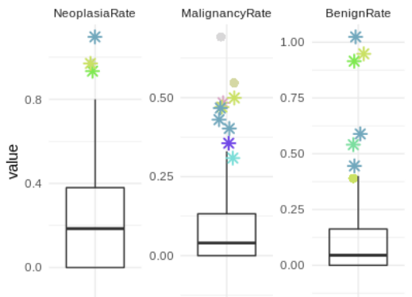
Publicly available species used in our current analysis
Peek at the 200 species of the Primate Conservation Sequencing Consortium (PCSC)
Note that more extreme values represent more diversity and, thus, more power
species labelled with (*) are those with available genomic information

Slide 6
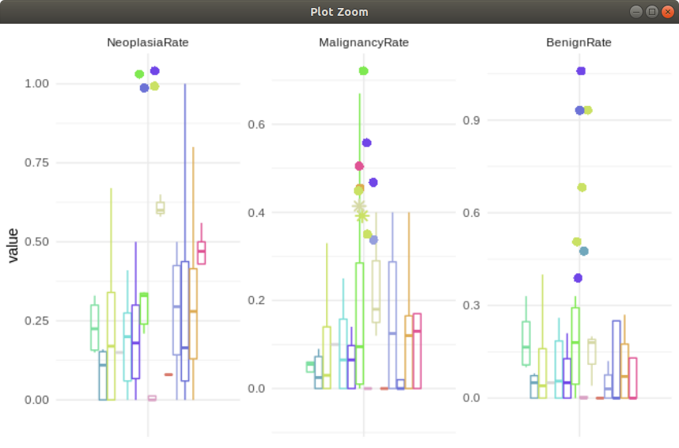
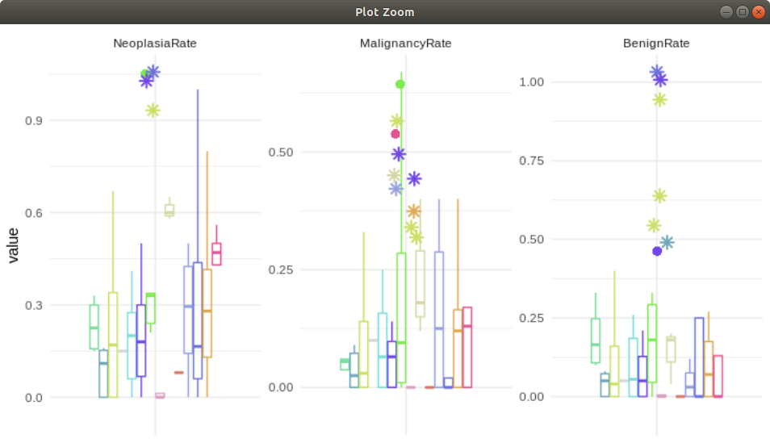
Publicly available species used in our current analysis
Peek at the 200 species of the Primate Conservation Sequencing Consortium (PCSC)
Note that more extreme values represent more diversity and, thus, more power
species labelled with (*) are those with available genomic information

Slide 7
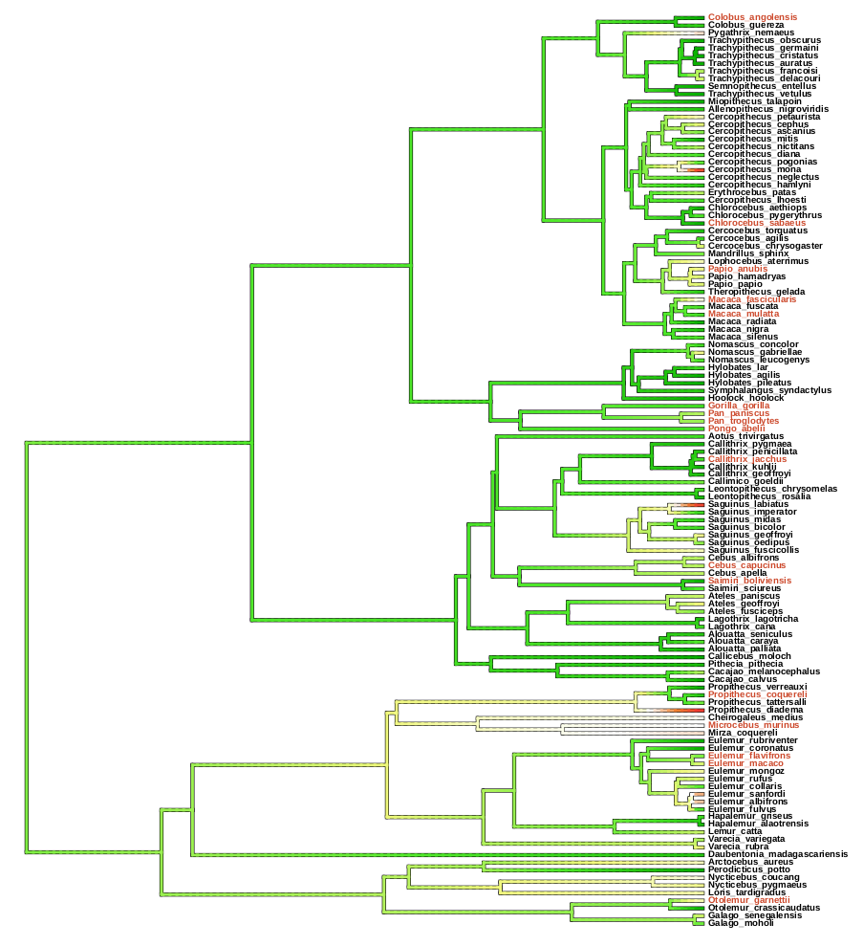
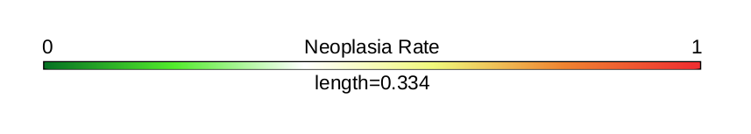
A preliminary analysis
We used 17 primate genomes coming from UCSC with available multiple sequence alignments for protein-coding regions

Slide 8
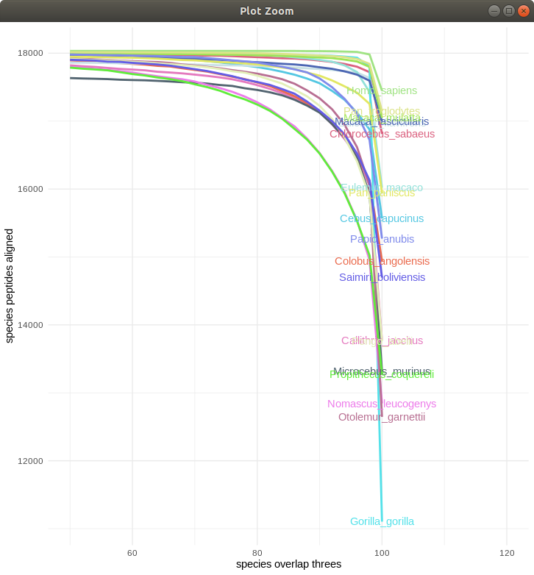
A preliminary analysis
The analyzed dataset is formed by 16.343 best quality transcript alignments representing a human gene. This has been used as our genomic dataset for trait analysis.

Slide 9
CAAS-based trait-association analysis
(Convergent Amino-Acid Substitution, CAAS)
Scenario 1
Scenario 2
Species 1 ---- P S T V Q L M P
Species 1 ---- P S T V Q L M P
Phenotype group A
Phenotype group A
Species 2 ---- P S T V Q L M P
Species 2 ---- P S T V Q L M P
Species 3 ---- P S T V Q L M P
Species 3 ---- P S T V Q L M P
Species 4 ---- P Q T V Q - M P
Species 4 ---- P S R V Q - M P
Phenotype group B
Phenotype group B
Species 5 ---- P Q T V Q L M P
Species 5 ---- P S P V Q L M P
Species 6 ---- P Q T - Q L M P
Species 6 ---- P S M - Q L M P

Slide 10
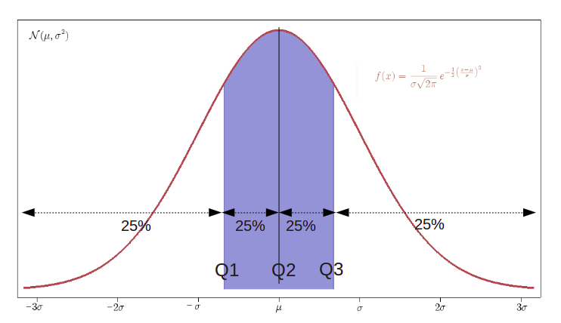
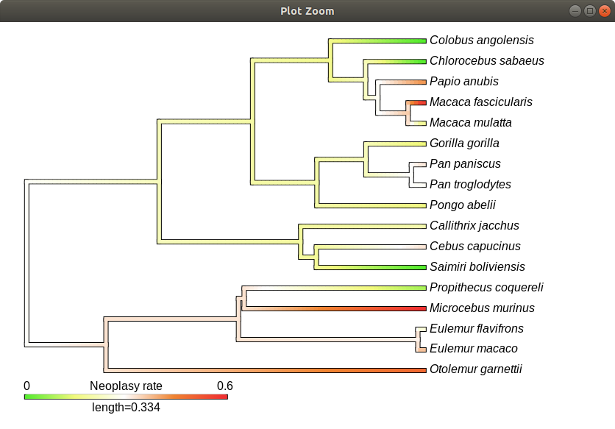
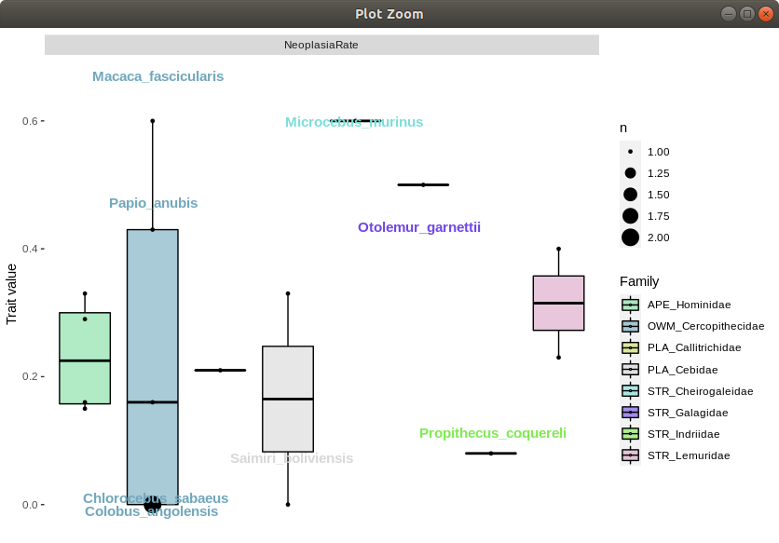
CAAS-based trait-association analysis
Group selection
Trait groups across phylogeny

Slide 11
First CAAS results
Malignancy Rate
Benign Rate
Neoplasy Rate
With higher risk
Macaca fascicularis
Microcebus murinus
Otolemur garnetti
77 genes
775 aa
With higher risk
Pan paniscus
Pan troglodytes
Papio anubis
Cebus capucinus
4 genes
13 aa
With higher risk
Papio_anubis
Macaca_fascicularis
Microcebus murinus
Otolemur garnetti
With lower risk
Propithecus coquereli
Saimiri boliviensis
Chlorocebus sabaeus
Colobus angolensis
127 genes
210 aa
Note that we did not yet test for statistical excess of detected genes.

Slide 12
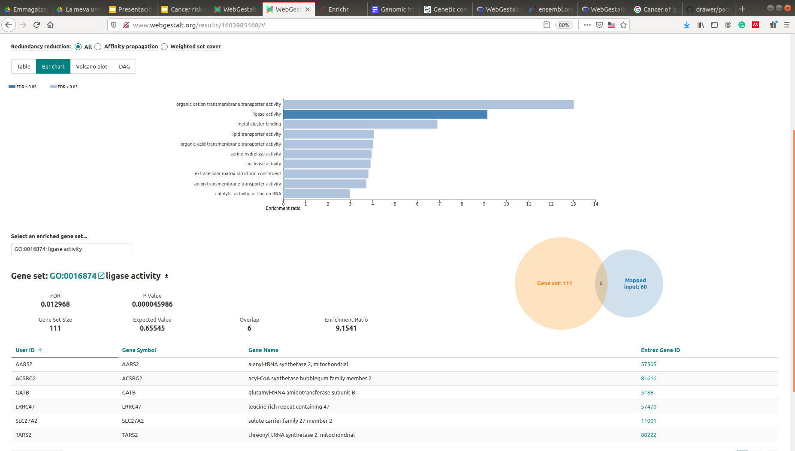
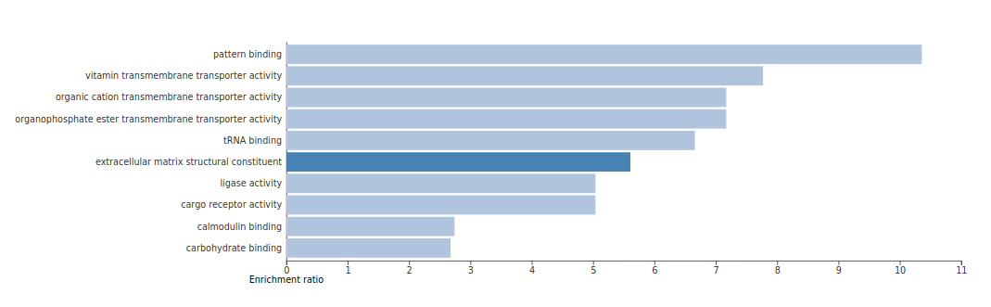
First CAAS results
WebGestaltR
Main molecular functions

Slide 13
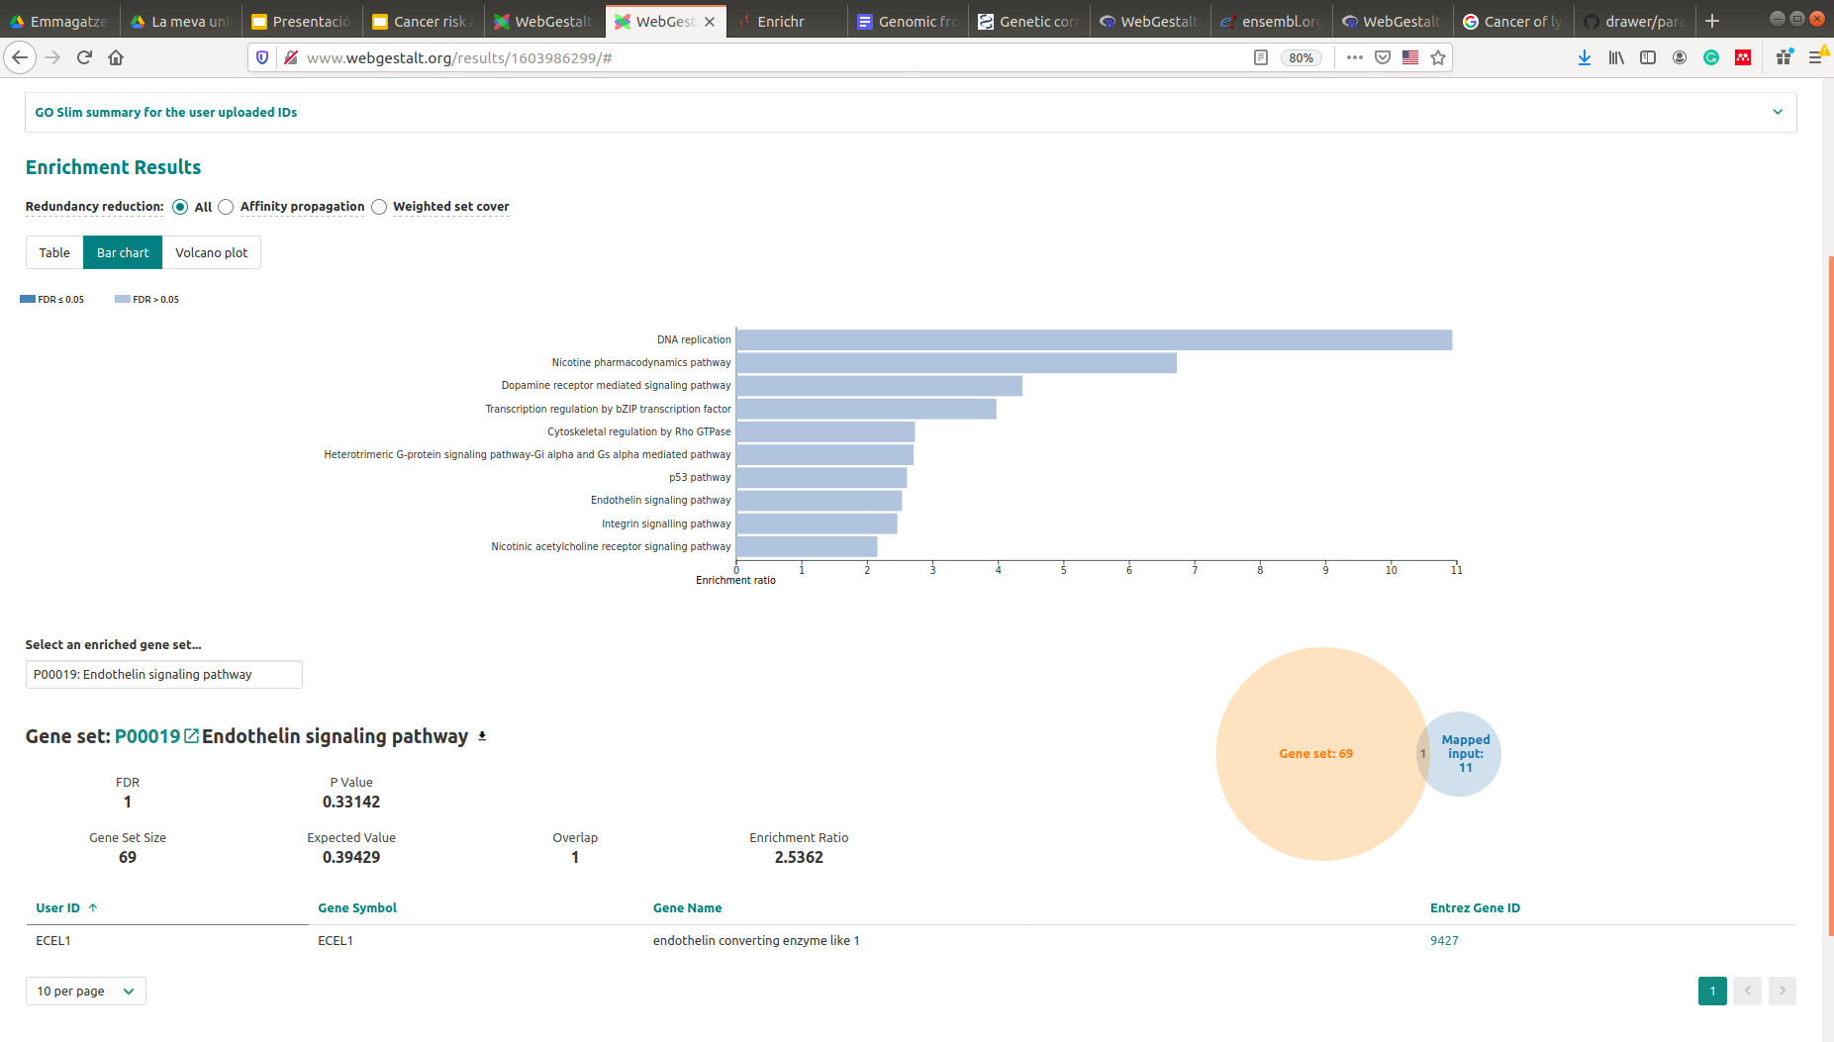
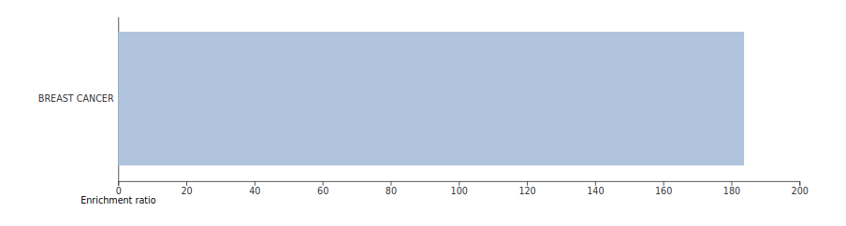
First CAAS results
WebGestaltR
Neoplasy Rate - Pathways and diseases
Scenarios 1+2

Slide 14
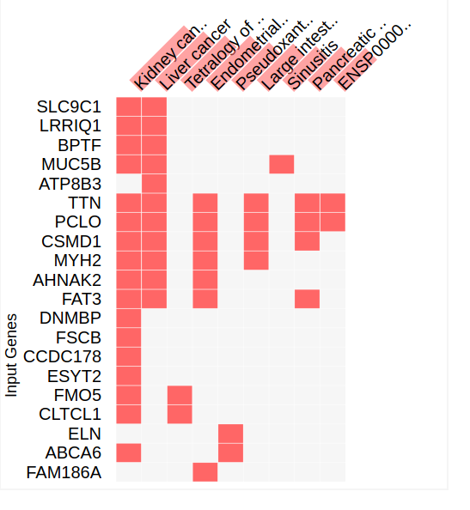
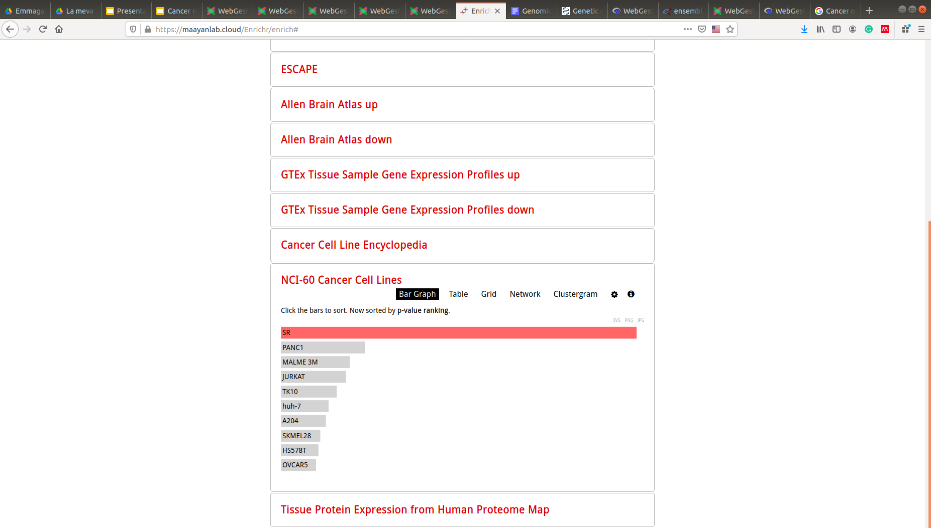
First CAAS results
enrichR
Neoplasia Rate - Cancer-linked insights
Scenarios 1+2

Slide 15
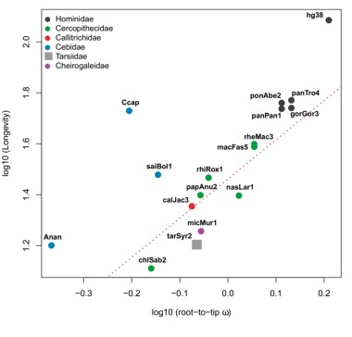
PGLS-based trait-association analysis
(Phylogenetic generalised least-squares, PGLS)
Regression between a genetic predictor variable (rates of protein evolution, measured as root-to-tip dN/dS) and a trait response variable (e.g., neoplasia rate) across a phylogeny,
controlling for non-independence of species data points
Muntané et al. (2018). Biological processes modulating longevity across primates: A phylogenetic genome-phenome analysis. Molecular Biology and Evolution

Slide 16
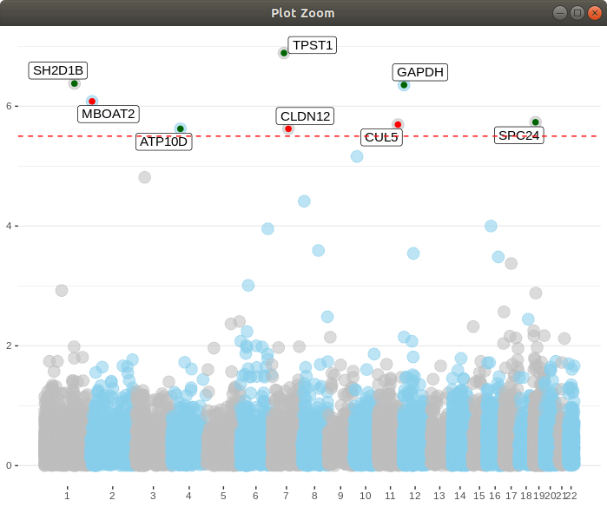
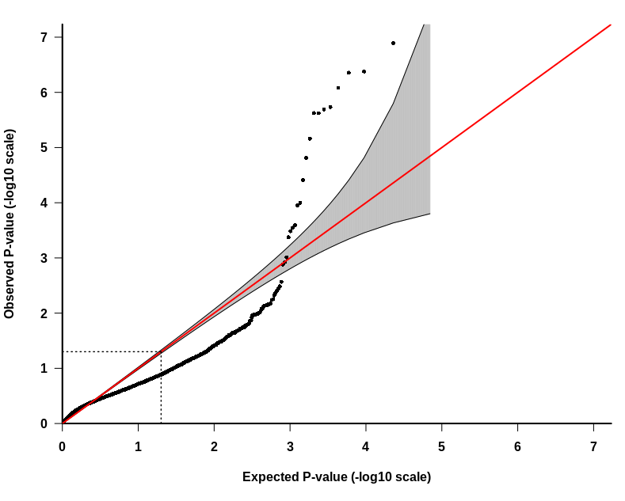
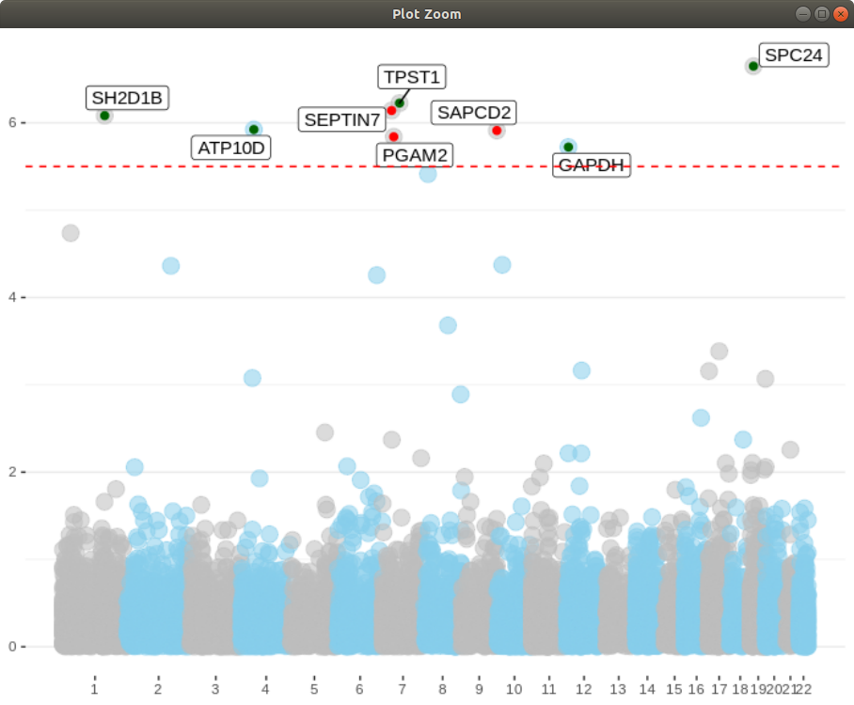
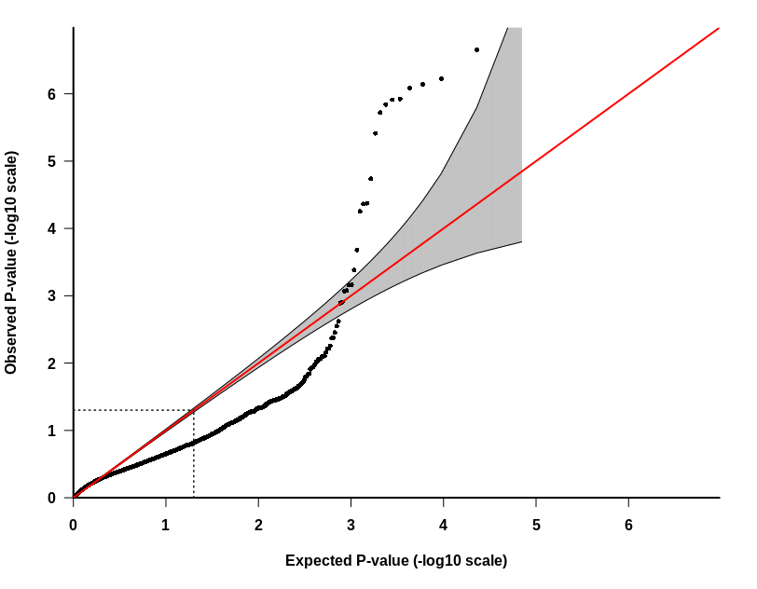
First PGLS results - Malignancy traits
+ correlation
- correlation
-log10(p-val)
Malignancy rate
red line → Bonferroni significance threeshold
Malignancy proportion over neoplasies
-log10(p-val)

Slide 17
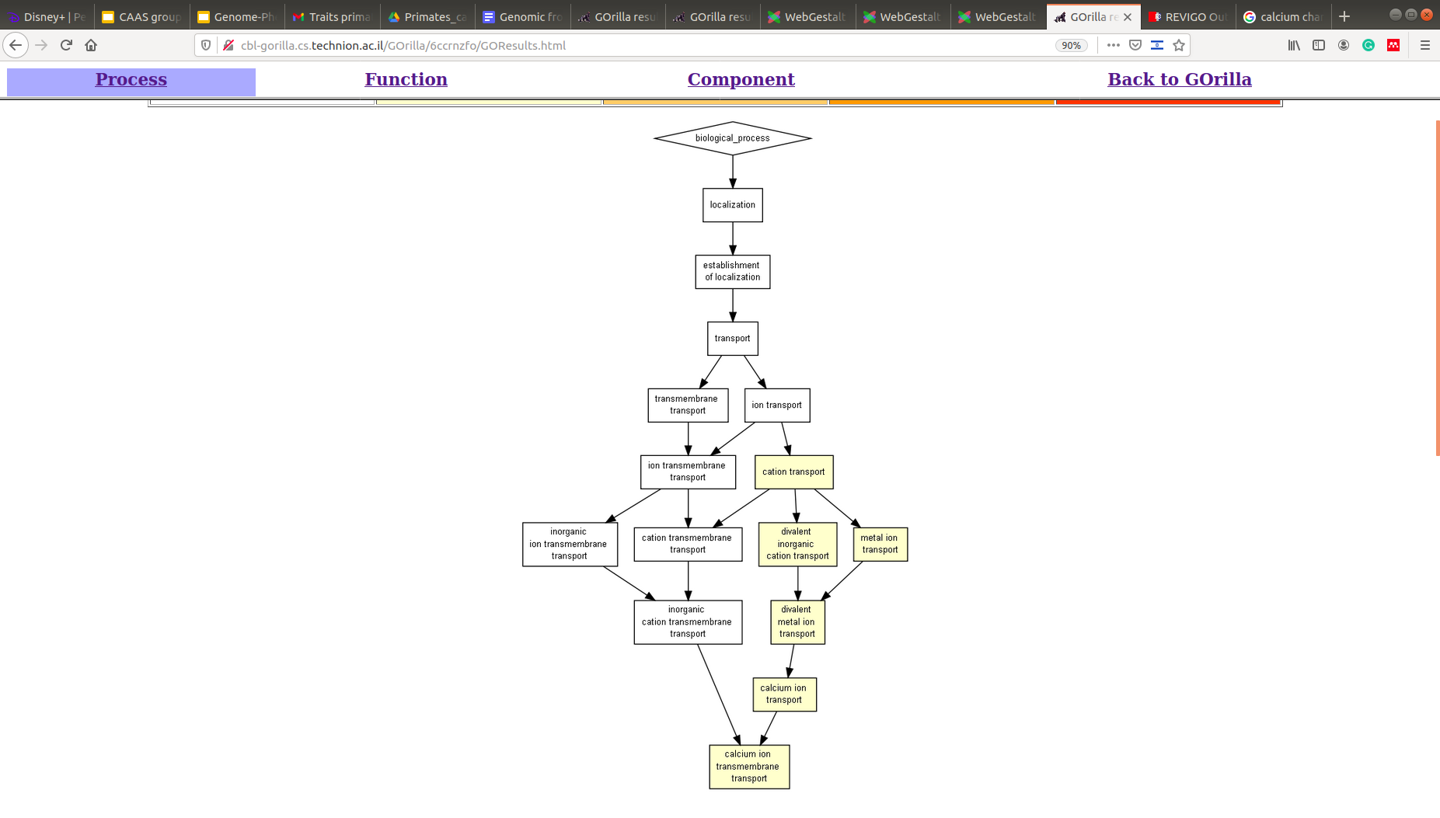
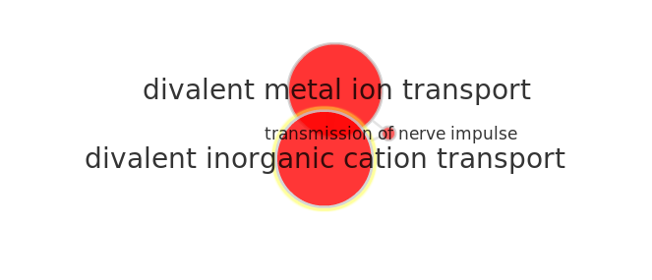
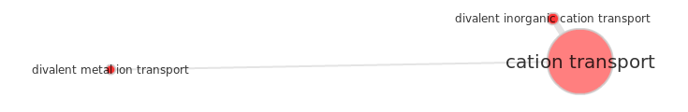
First PGLS results - Malignancy traits
Target genes enrichment
Top 50-100 genes ranked by p-value
> Link with calcium/ion transport channels
(pval < 10-3)

Slide 18
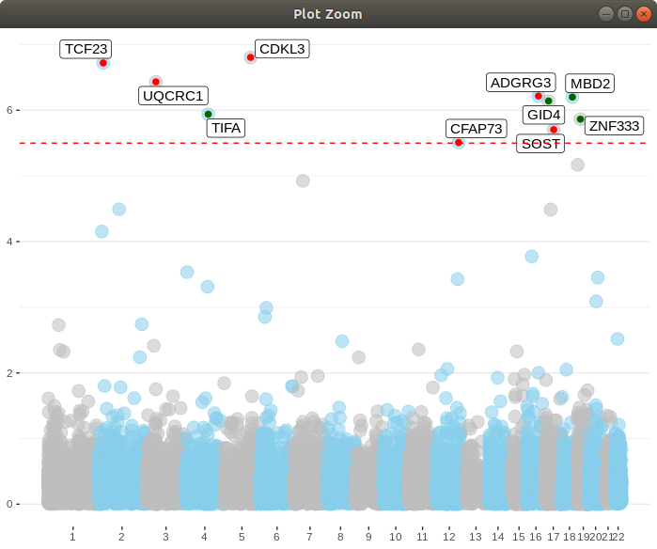

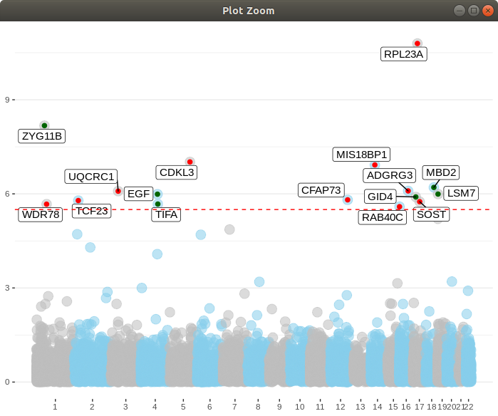
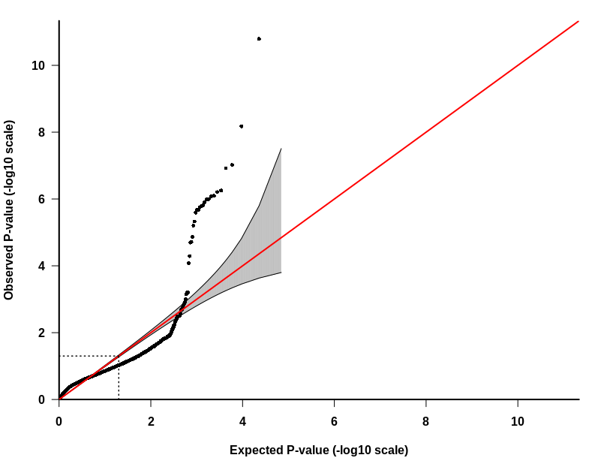
First PGLS results - Benignancy traits
+ correlation
- correlation
Benignancy rate
-log10(p-val)
red line → Bonferroni significance threeshold
Benignancy proportion over neoplasies
-log10(p-val)

Slide 19
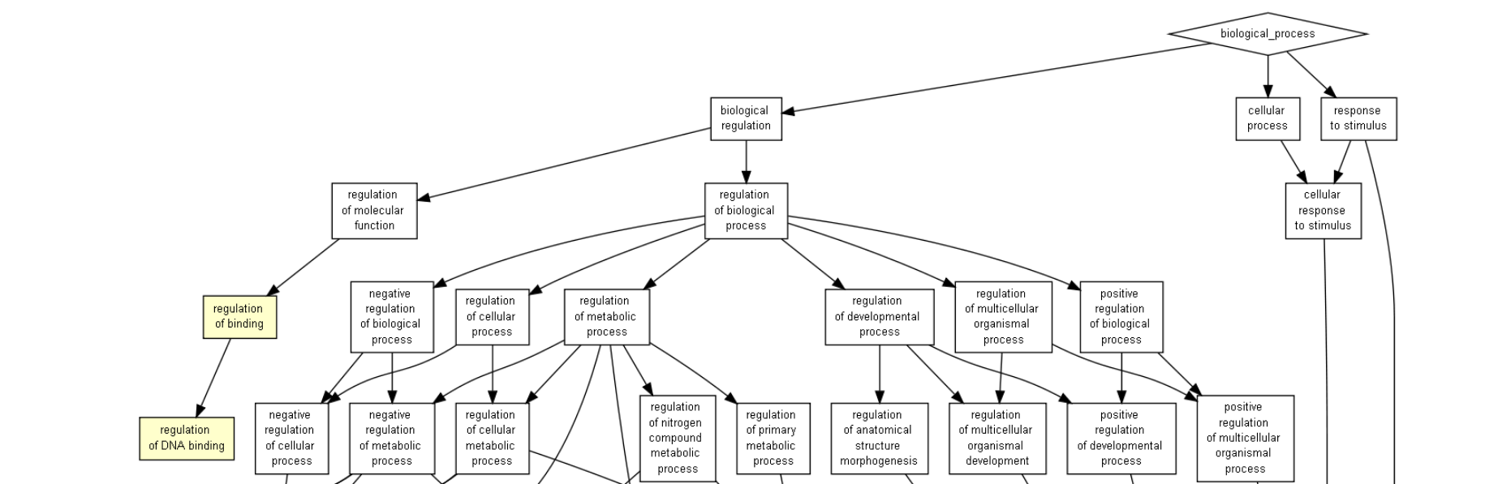
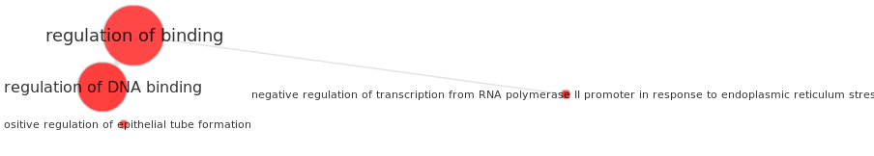
First PGLS results - Benignancy traits
Target genes enrichment
> Link with DNA Binding
(pval < 10-3)

Slide 20
Final remarks and some questions
We already have a bunch of interesting preliminary results.
With more species, we will have more extreme phenotypic values, and thus more power.
Before a final analysis, we need to clarify a few things:
Given huge correlations.What are the most relevant traits?
Are there different qualities in different traits?
Do we know if these traits belong to specific cancer types?
Are these traits linked to other relevant experimental results?
...

